Slide 1
11-01. Validation (Evaluation)
Youngsoo Kim <pineland@hanmail.net>
Code : https://github.com/pineland/AIDA/

Slide 2
Outline
Motivation
Hold-out
Cross validation
Bootstrap
Three-way data splits
Confusion matrix

Slide 3
Motivation
Validation techniques are motivated by two fundamental problems in ML.
Model selection
Almost all ML algorithms have one or more free parameters to be tuned.
e.g.) The number of neighbors in kNN, The network size,
learning parameters and weights in MLPs, etc.
Performance estimation
Only limited dataset are available in estimation.
Validation with training data leads to overfitting.
It is better to split the training data into disjoint subsets (holdout method)

Slide 4
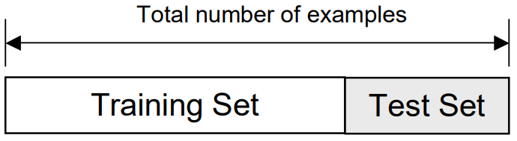
Hold-out method
Split dataset into two groups.
Training set : use for training the classifier
Test set : use for estimating the error rate of the trained classifier
The holdout method has two basic drawbacks.
We may not be able to afford the “luxury” of setting aside a portion of the dataset for testing.
In case of a single train-and-test experiment, the holdout estimate can mislead if we happen to get an “unfortunate” split.

Slide 5
Cross validation (CV), Bootstrap
The limitations of the holdout can be overcome with CV and bootstrap.
Sort of CV
Random Subsampling
K-Fold Cross-Validation
Leave-one-out Cross-Validation
Bootstrap

Slide 6
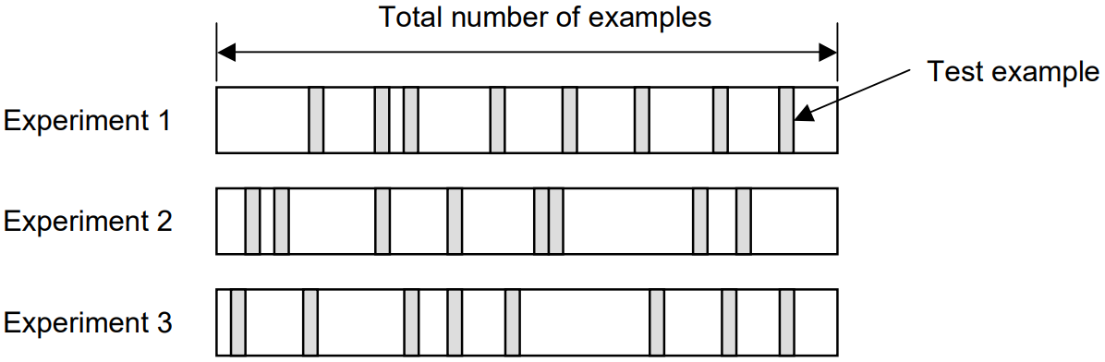
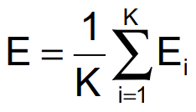
Random Subsampling
Performs K data splits of the dataset
Each split randomly selects a fixed number (K) examples without replacement.
For each data split, we re-train the classifier with the training examples, and estimate E_{i} with the test examples.
The final error estimate,

Slide 7
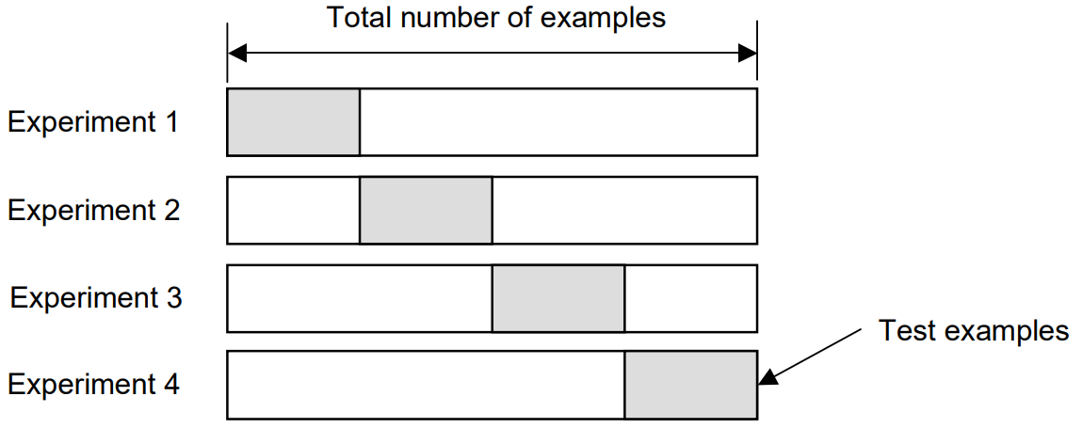
K-Fold Cross-validation
Create a K-fold partition of the dataset.
For each of K experiments, use K-1 folds for training and the remaining one for testing.
All the examples in the dataset are eventually used for both training and testing.

Slide 8
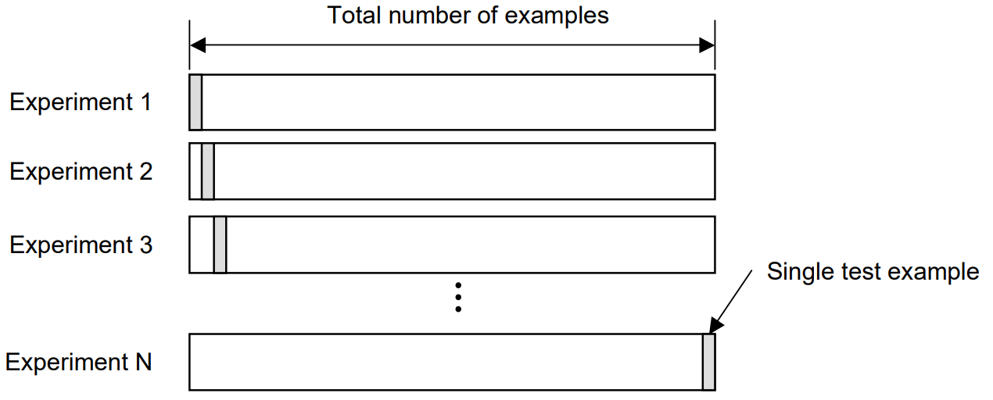
Leave-one-out Cross Validation
Leave-one-out is the degenerate case of K-Fold Cross Validation, where K is chosen as the total number of examples.
For a dataset with N examples, perform N experiments.
For each experiment, use N-1 examples for training and the remaining example for testing.

Slide 9
How many folds are needed?
With a large number of folds
The bias of the estimator will be small. (the estimator will be very accurate)
The variance of the estimator will be larger.
The many experiments will be needed as well.
With a small number of folds
The number of experiments are reduced.
The variance of the estimator will be small.
The bias of the estimator will be large (higher than the true error rate)
In practice, the choice of the number of folds depends on the size of the dataset

Slide 10
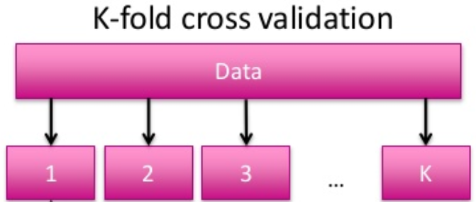
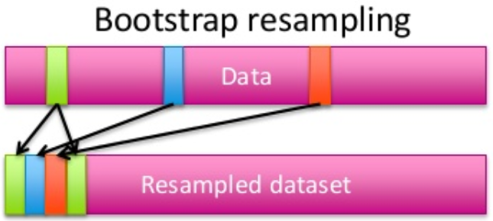
Bootstrap
CV uses sampling without replacement.
The same instance, once selected, can not be selected again for a particular training/test set
The bootstrap uses sampling with replacement to form the training set.
Do sampling n instances with replacement to form a new dataset of n instances for training.
From the original dataset, use the instances that don’t occur in the new training set for testing.
test

Slide 11
Three-way data splits (1)
If model selection and true error estimates are to be computed simultaneously, the data needs to be divided into three disjoint sets.
Training set : a set of examples used for learning to fit the parameters of the classifier
Validation set : a set of examples used to tune the parameters of the classifier
Test set : a set of examples used only to assess the performance of a fully-trained classifier
Why separate test and validation sets?
The error rate estimate of the final model on validation data will be biased (smaller than the true error rate) since the validation set is used to select the final model.

Slide 12
Three-way data splits (2)
Procedure
Divide the available data into training, validation and test set.
Select architecture and training parameters of model.
Train the model using the training set.
Evaluate the model using the validation set.
Repeat steps 2 through 4 using different architectures and training parameters
Select the best model and train it using data from the training and validation set.
Assess this final model using the test set.
This outline assumes a holdout method
If CV or Bootstrap are used, steps 3 and 4 have to be repeated for each of the K folds.

Slide 13
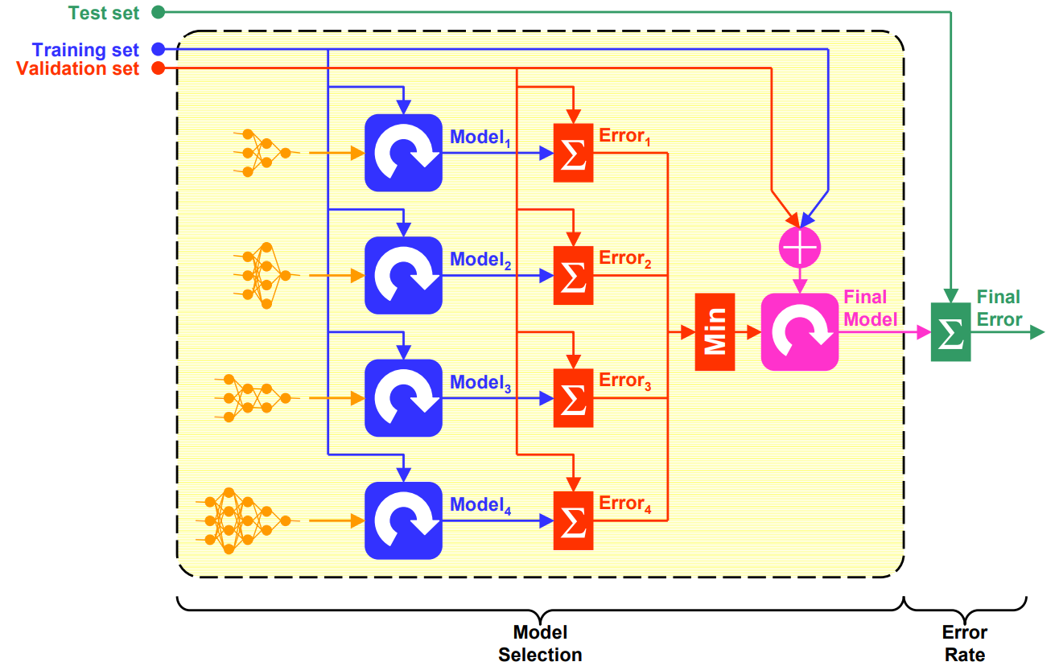
Three-way data splits (3)

Slide 14
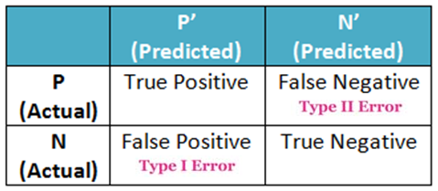
Confusion Matrix
A table describing the performance of a model.
The matrix consists of 4 values and 2 dimensions.
True Positive
False Negative (Type 2 Error)
e.g.) Classifying a spam mail as non-spam
False Positive (Type 1 Error)
e.g.) Classifying a non-spam mail as spam
True Negative
Precision = TP / (TP + FP)
Recall = TP / (TP + FN)
Accuracy = (TP + TN) / Total
F-1 score = 2 * (Precision +
Recall / Precision * Recall)

Slide 15

Q & A

